Slide 1
Customer Churn Prediction
UE20CS302 – Machine Intelligence
Mini Project
Project Title : Customer churn prediction
Team No: 12
Project Guide : Gokul Srinivasan
Project Team with SRNs : Chandan Kumar S PES2UG20CS804
Vijay.J PES2UG20CS815
Yuvaraj.S PES2UG20CS819

Slide 2
Problem Statement
Customer Churn Prediction Using Machine Learning
->Customer churn, also known as customer retention, customer turnover, or customer defection, is the loss of clients or customers.
->Objective : The aim is to estimate whether a bank's customers leave the bank or not. The event that defines the customer abandonment is the closing of the customer's bank account
->Customer churn is a common problem across businesses in many sectors. If you want to grow as a company, you have to invest in acquiring new clients. Every time a client leaves, it represents a significant investment lost. Both time and effort need to be channelled into replacing them
Notes:
Provide a basic introduction of the project and also an overview of scope it entails.
Set the context.

Slide 3
Application and Uses
1)By knowing which clients are at the highest risk of leaving, we can better target our rescue efforts. For example, we can reach out to these clients with a marketing campaign, reminding them that they haven’t purchased from us in a while, or even offering them a benefit
2) In addition to knowing which clients to target, we can use the churn model to calculate the maximum benefit price that is still worthwhile
3) It is also important to be careful about how far in advance we want to estimate the propensity to leave. In other words, how long is the time between the day we look at clients through the available features and the day we can tell if they have left? If that time is too short, we won’t have much time to make any kind of response. If, on the other hand, it is too long, the model will be less accurate and up to date
Notes:
Provide a basic introduction of the project and also an overview of scope it entails.
Set the context.

Slide 4
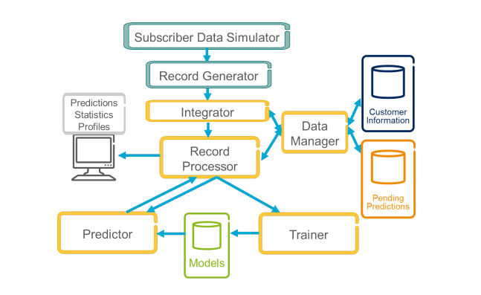
High level Architecture
Integrator:
The system processes as input a number of streams with diverse information. For example, a stream of call records, a stream with billing actions by the company and bill payments by the subscribers, contents from social networking services such as Twitter, etc. The Integrator module integrates all these streams, generating a logically unique stream of events.
Data Manager : The Data Manager module manages the customer information database and the Pending Predictions queue. The customer information database contains basic information about our subscribers (age, address, type of contract, etc.) as well as highly dynamic information (e.g. last numbers called, most frequently numbers called).
Notes:
Provide a basic introduction of the project and also an overview of scope it entails.
Set the context.

Slide 5
Literature Survey
Title of the paper | Year of Publication | Journal/Conference Name | Advantages | Limitations
A Survey on Customer Churn Prediction using Machine Learning Techniques | November 2016 | International Journal of Computer Applications (0975 8887) Volume 154 No.10, | The company's churn rate is that it provides clarity on how well the business is retaining customers, which is a reflection on the quality of the service | It does not execute very well when the data set has more sound i.e. target classes are overlapping. In cases where the number of properties for each data point outstrips the number of training data specimens
A Proposed Churn Prediction Model | June-July 2012, pp.693-697 | Essam Shaaban, Yehia Helmy, Ayman Khedr, Mona Nasr / International Journal of Engineering Research and Applications (IJERA) | A model will identify which of these attributes has the highest predictive value and, ultimately, whether the visitor to the company’s website will make a purchase. | One of the limitations of decision trees is that they are largely unstable compared to other decision predictors.
A Prediction Model of Customer Churn considering Customer Value: | Published 9 August 2021 | Hindawi Discrete Dynamics in Nature and Society | The model works comparably well when there is an understandable margin of dissociation between classes. It is more productive in high dimensional spaces. | The operating data from only one telecom operator are taken into account in the research; that is to say, the selection of data is limited to some extent,
Notes:
Provide summary of Phase – 1.
Include the suggestions and improvements made.

Slide 6
Literature Survey
Title of the paper | Year of Publication | Journal/Conference Name | Advantages | Limitations
Customer Churn Prediction Model | 2020 | (IJACSA) International Journal of Advanced Computer Science and Applications, Vol. 11, No. 5, | The importance of this research paper comes from the importance of customer churn in the telecom sector. It helps companies to make more profit as customer churn is considered as one of the most important sources of income for the telecom sector. | Logistic Regression is strictly a classification method and it has lots of competition. (SVMs, Naive Bayes, Random Forests, kNN etc.)
Model of Customer Churn Prediction on Support Vector Machine | January 2008 | Online English edition of the Chinese language journal | SVM is a general learning arithmetic based on the statistics learning theory, and it can solve the nonlinearity, high dimension, and local minimization problems, which are insoluble for traditional methods in the customer churn prediction of telecommunication | It does not execute very well when the data set has more sound i.e. target classes are overlapping.
Building comprehensible customer churn prediction models with advanced rule induction techniques | 2010 | Expert Systems with Applications ,An international journal | As churn prediction models should be both accurate and comprehensible, we will focus on the use of rule-based classification techniques. | they may become very hard to reason about and verify, due to their complexity and possible
Notes:
Provide summary of Phase – 1.
Include the suggestions and improvements made.

Slide 7
Literature Survey
Title of the paper | Year of Publication | Journal/Conference Name | Advantages | Limitations
Systems Engineering — Theory & Practice | SETP, 2008 | Volume 28, Issue 1, January 2008 Online English edition of the Chinese language journal | the accuracy achieved with random forest is far much higher than the decision tree technique which clearly states that random forest is an efficient technique. | Prediction accuracy on complex problems is usually inferior to gradient-boosted trees.
Customer churn prediction in telecom using machine learning in big data platform | 2019 | Correspondence: Abdelrahim.ahmad@hiast. edu.sy Faculty of Information Technology, Higher Institute for Applied Sciences and Technology, Damascus, Syria | The hybrid modulation network implements hierarchical information abstraction, enabling meta-continual learning of multiple tasks. | disadvantages of GA and BP algorithms, and presents the iteration of hybrid algorithm based on both algorithms.
Customer churn prediction by hybrid neural networks | 2009 | journal homepage: www.elsevier.com/locate/eswa | t’s easy to understand and simple to implement. It can be used for both classification and regression problems. It’s ideal for non-linear data since there’s no assumption about underlying data. | It is a lazy learner i.e. it uses all the training data at the runtime and hence is slow
Notes:
Provide summary of Phase – 1.
Include the suggestions and improvements made.

Slide 8
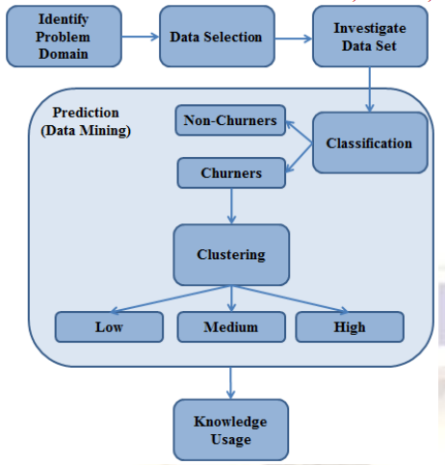
Proposed Approach
THE PROPOSED MODEL
The proposed model is composed of six steps. As shown in figure 1, these steps are: identify problem domain, data selection, investigate data set, classification, clustering and knowledge usage. As figure 2 depicts; the classification step produces two types of customers (churners and non-churners) while the clustering step produces 3 clusters which are used to be evaluated according to the retention strategy in further usage.
The proposed model can produce more than 3 clusters based on the types of acquired knowledge. Knowledge usage receives the produced clusters for assign a retaining solution for each type of churners
Notes:
Provide summary of Phase – 1.
Include the suggestions and improvements made.

Slide 9
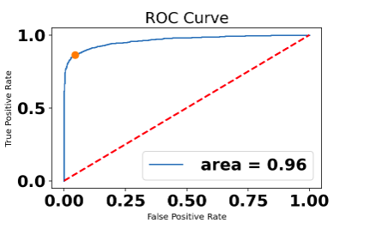
Results and Discussion
Churn prediction and management is very important for enterprises in the competitive market to predict possible churners and take proactive actions to retain valuable customers and profit. Therefore, to build an effective customer churn prediction model, which provides a certain level of accuracy, has become a research problem for both academics and practitioners in recent years.
In this paper, we consider two different hybrid data mining techniques by neural networks to examine their performances
Where in the confusion matrix for
non - churn & non - churn value is 1502.0
Non - churn & churn value is 71.0
Churn & non - churn value is 217.0
Churn value & churn value is 1356.0
The rate of the curve for the lightgbm is 0.96
Notes:
Provide summary of Phase – 1.
Include the suggestions and improvements made.

Slide 10
Refrences
Paper1: International Journal of Computer Applications (0975 8887)
Volume 154 No.10, November 2016. A Survey on Customer Churn Prediction using Machine
Learning Techniques
Paper 2: International Advanced Research Journal in Science, Engineering and Technology
Vol. 8, Issue 6, June 2021
Paper 3: International Journal for Research in Applied Science & Engineering Technology (IJRASET)ISSN: 2321-9653; IC Value: 45.98; SJ Impact Factor: 7.429Volume 8 Issue V May 2020- Available at www.ijraset.com©IJRASET: All Rights are Reserved Telecom Customer Churn Prediction
Paper 4: Building comprehensible customer churn prediction models with advanced rule induction techniques
Paper 5: DOAA, M. E.; MOHAMED, H. A survey on sentiment analysis challenges. Journal of King Saud University-Engineering Sciences, 2016, 4.
Paper 6: GAUR, Abhishek; DUBEY, Ratnesh. Predicting Customer Churn Prediction In Telecom Sector Using Various Machine Learning Techniques. In: 2018 International Conference on Advanced Computation and Telecommunication (ICACAT). IEEE, 2018. p. 1-5.
Paper7: VAFEIADIS, Thanasis, et al. A comparison of machine learning techniques for customer churn prediction. Simulation Modelling Practice and Theory, 2015, 55: 1-9.
Notes:
Provide summary of Phase – 1.
Include the suggestions and improvements made.

Slide 11
Thank You

